Slide 1
Effectiveness of small MPAs in Palau in meeting fisheries objectives
A.L. Isechal*, J.W. Idechong, N. Oldiais, A. Merep, D. Olsudong, J. Andrew, G. Mereb, S. Nakaya and Y. Golbuu
Palau International Coral Reef Center

Slide 2
Background
Bigger MPA are generally better
Reserve effect on biological measures appear to be independent of reserve size (Halpern 2003)
Palau’s community-based MPA development—smaller MPAs
Effectiveness of these MPAs have often been presumed given ban on extraction

Slide 3
Question and objective
Question:
Are small MPAs in Palau effective?
Objective:
Examine the effects of MPAs on fish density and biomass in 4 marine protected areas

Slide 4
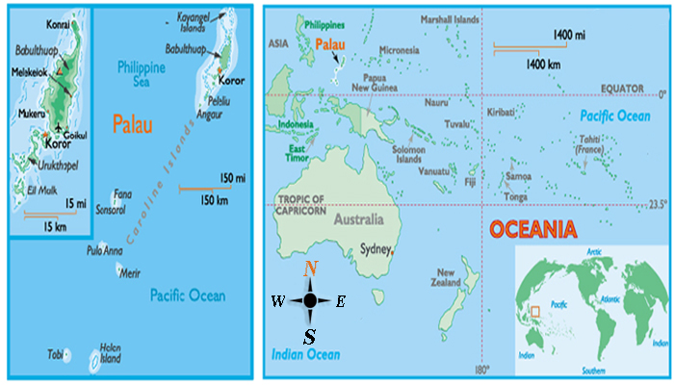
Study location

Slide 5
Study sites
Ileyakl Beluu MPA
0.65 km2
2005
Ngemai MPA
1.0 km2
2010
Teluleu MPA
0.83 km2
2001
Ebiil MPA
19.1 km2
1999
Channel and adjacent barrier reef
Barrier reef
Patch reef
Seagrass and reef flat

Slide 6
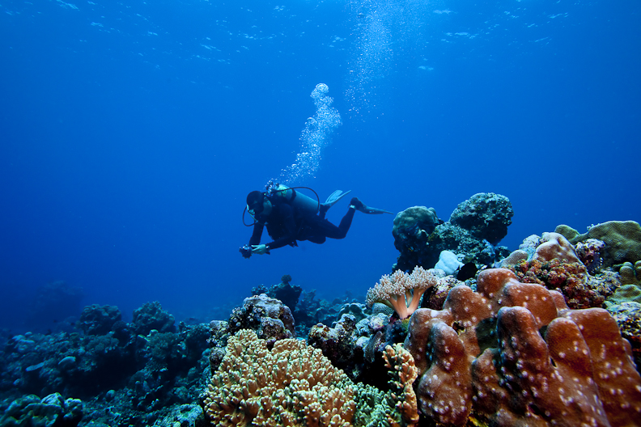
Methods
3 stations inside MPA 3 station at the reference site
5 replicate 50x5m belt transects
Targeted fish species

Slide 9
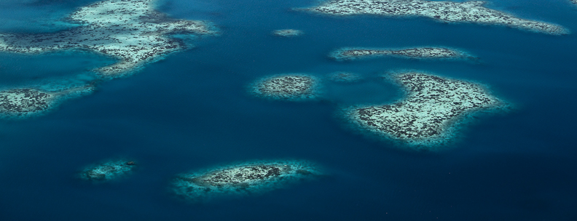
Conclusion
Small MPAs can be effective
There are other factors to consider
Level of enforcement
Length of closure

Slide 10
Implications
Snap shots to trends—establishing long term monitoring
Addressing threats originating from outside the MPA
Networks of small MPAs
Include social aspect—resource users
Improving management frameworks and institutions

Slide 11
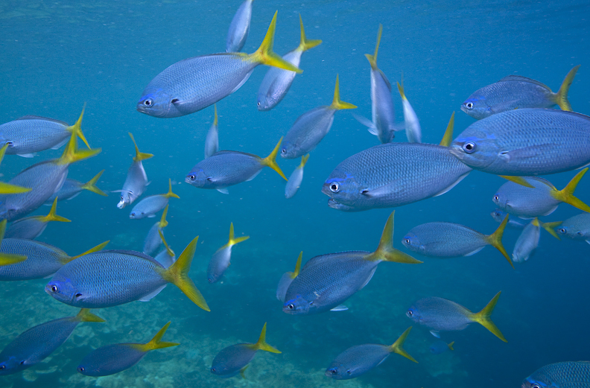
Acknowledgement
JICA
David & Lucile Packard Foundation
State managers and rangers
Communities
Palau International Coral Reef Center
Ian Shive (photos)

